Slide 1
Digital Banking Solution Doc
DBX 4.2.6

Slide 2
What is the Kony DBX ?
DBX Solution layers
Digital Banking suite of applications (Client Applications like Retail Banking,Customer360,OnBoarding )
Digital Banking Platform (Fabric Server)
Secure data storage and integration.( DataBases, other 3rd Party APIs)

Slide 3
Model Driven Architecture
MDA Architecture
Typical Decoupled MVC (Model View Controller) architecture, but with additional controller and model abstraction layers.
Decouples the view (UX/IU), Business logic, and integration components
Allows Extend and customize the solution without breaking the upgrade path

Slide 4
MDA Application Workflows

Slide 5
Sharable Code Across Web and Native App
Forms & View Controller are unique to each project
Presentation/Business controller and Model objects may be shared )
Presentation controllers may be unique to the Web or Native projects in some cases

Slide 6
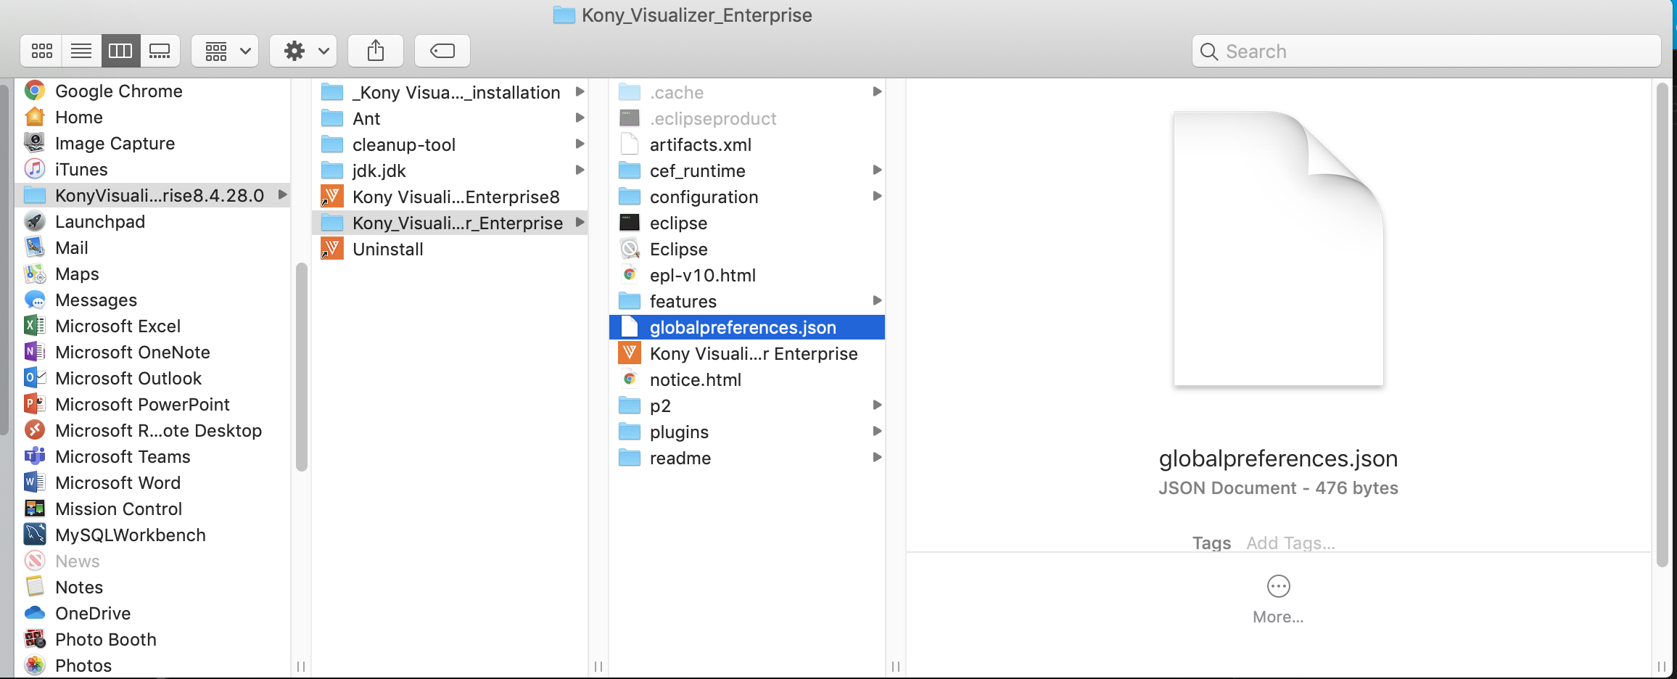
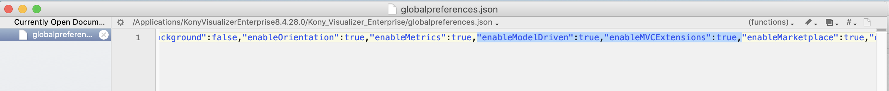
Visualizer Tooling Support
1. Enable Model Driven and MVC Extensions

Slide 7
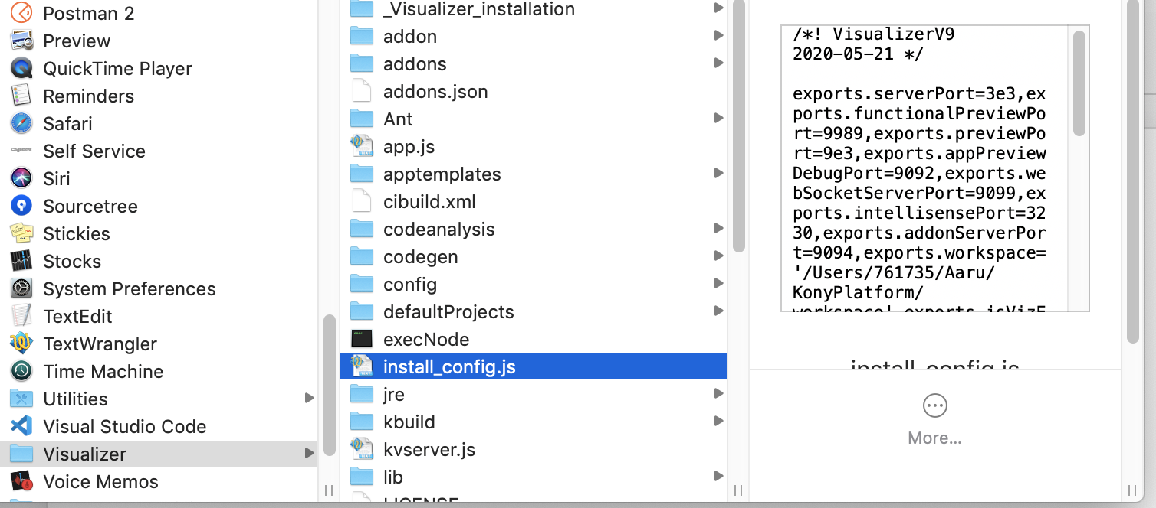
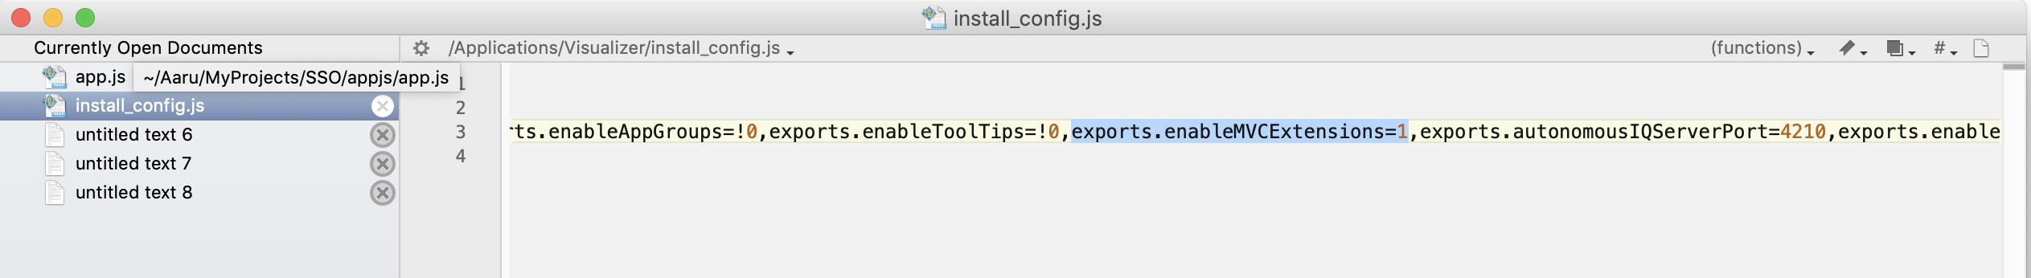
Visualizer Tooling Support 9.X
1.1. Enable Model Driven and MVC Extensions

Slide 8
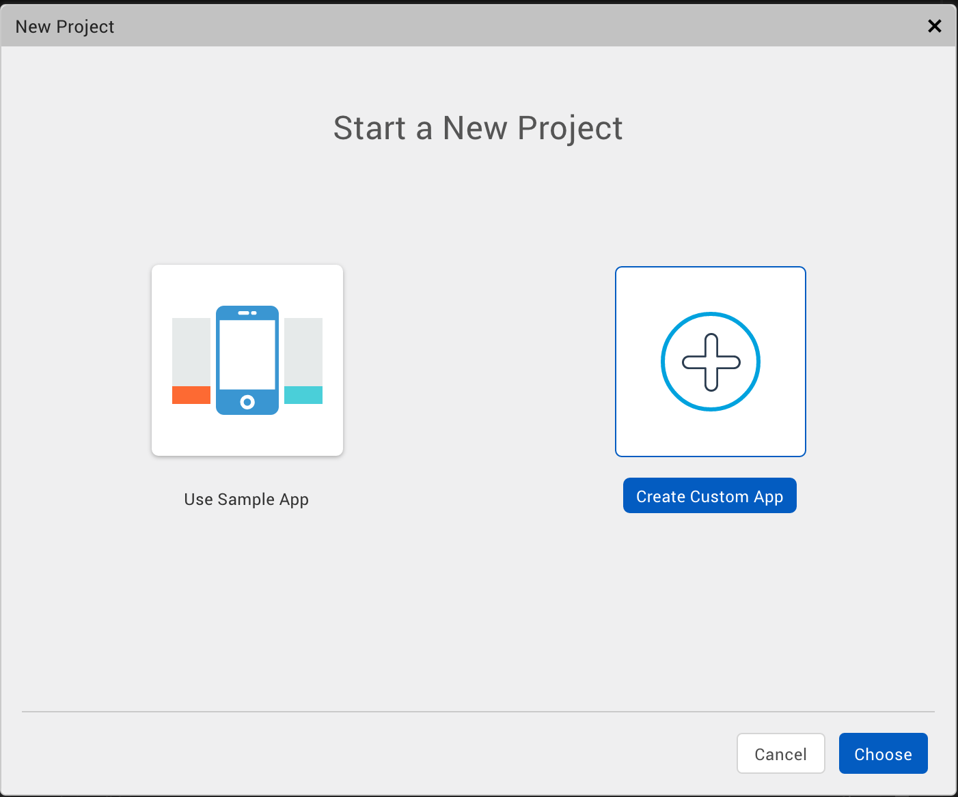
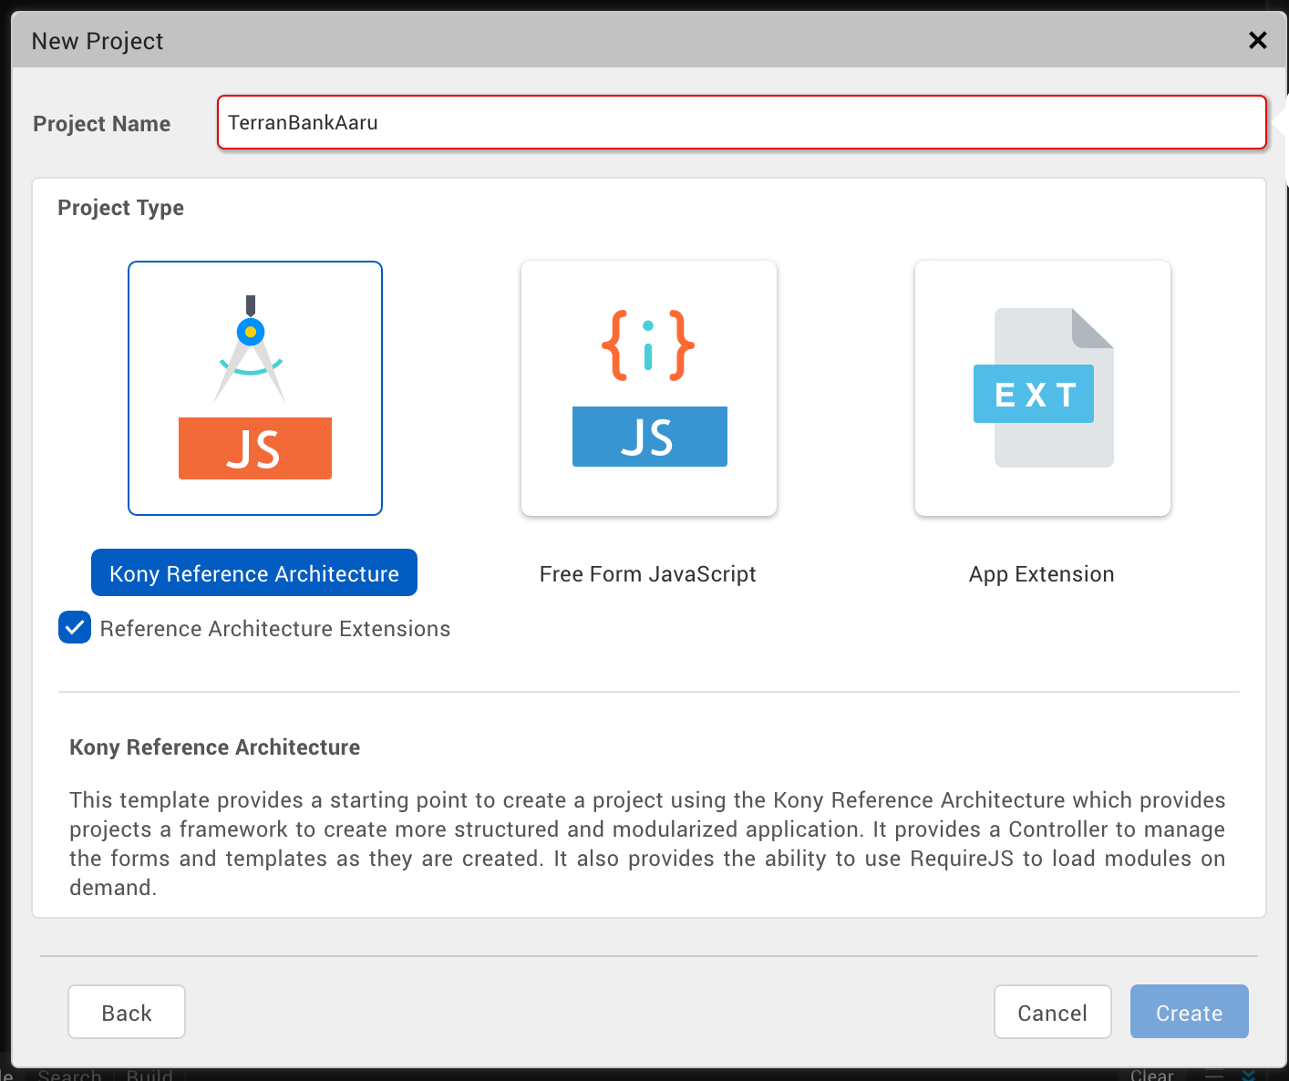
Visualizer Tooling Support
2. Creating Project

Slide 9
Visualizer Tooling Support
3.Project Structure

Slide 10
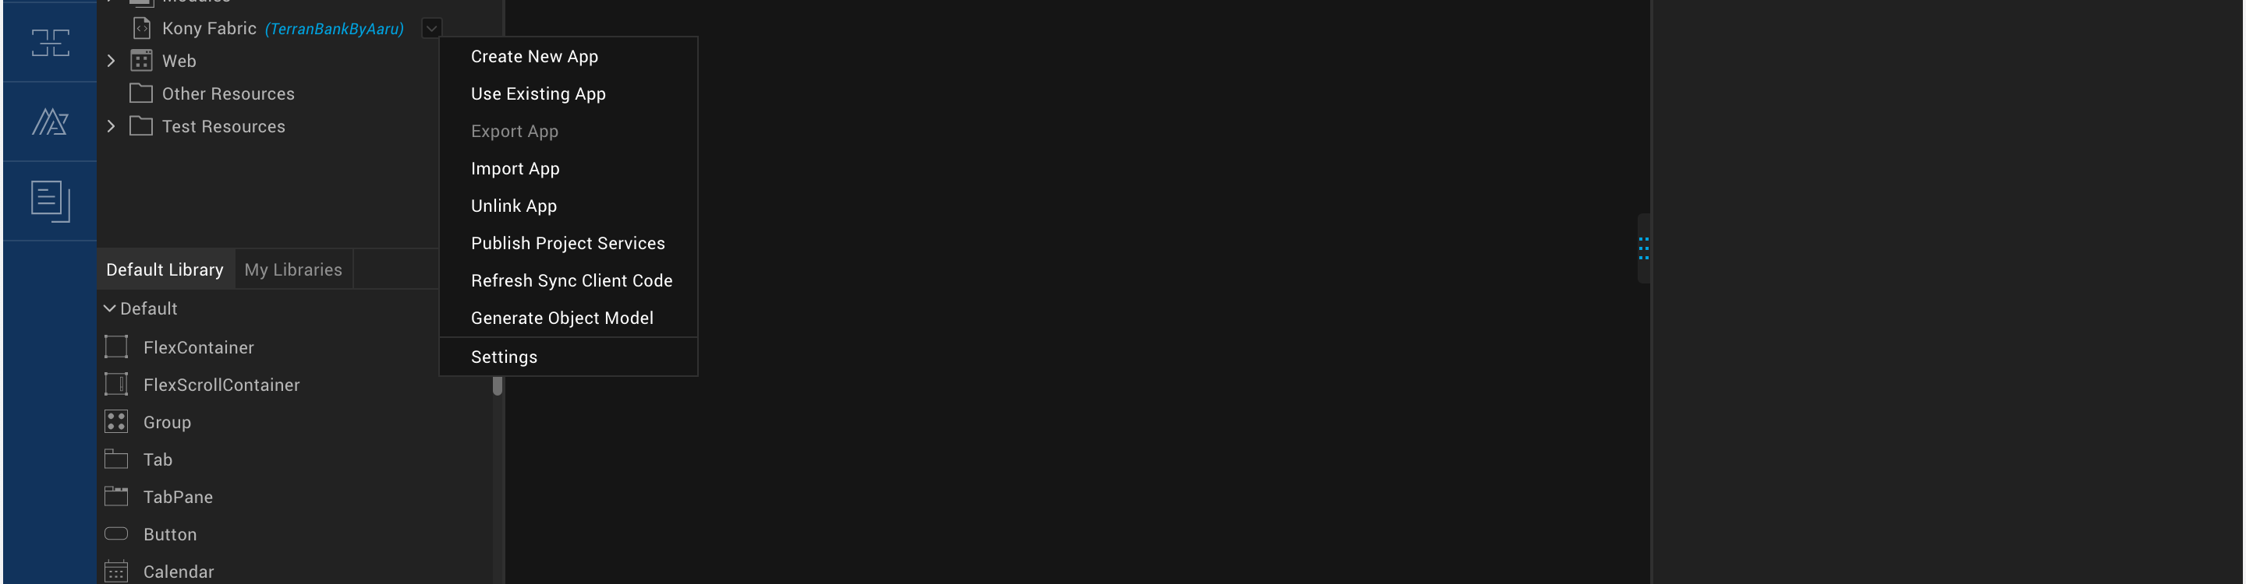
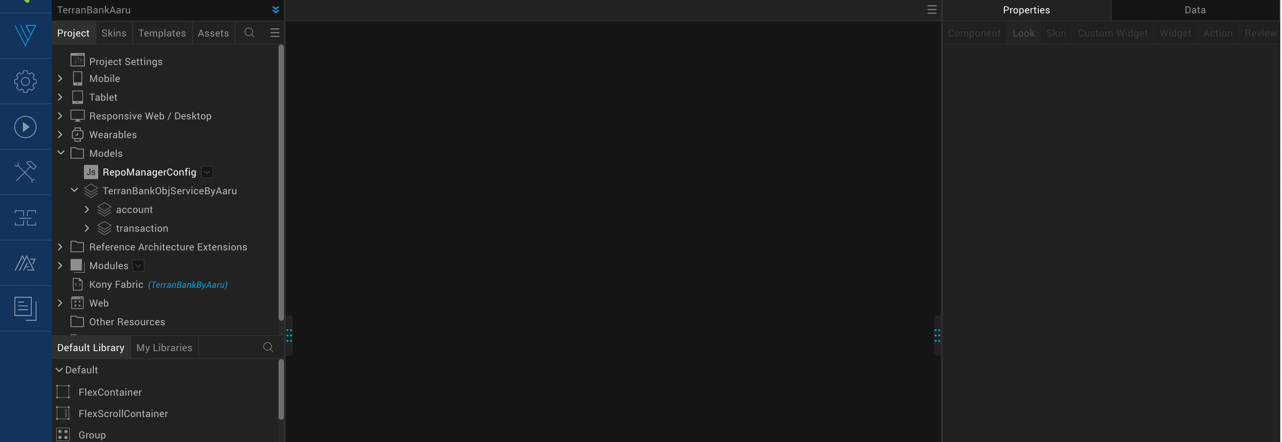
Visualizer Tooling Support
4.Generate Models

Slide 11
END

